Slide 1
Title of the talk/event
Presenter & other info

Slide 2
To note:
The font used is Jost (Jost medium for titles & for highlighting and Jost regular for text)
You can download the Font family for free here as it does not come pre-installed: https://fonts.google.com/specimen/Jost
Don‘t forget to install it on your computer (as well as in the computer used during the live presentation) after downloading it.
The identity color of ADVANCE-TB is:
HEX: #7ACDD0
RGB: 122, 205, 208
Other colors of ADVANCE-TB are also:
HEX: #005C6D
RGB: 0, 92, 109
HEX: #EAB49A
RGB: 234, 181, 154
On the „Resources – Communication Kit“ section of our website you can find the visual identity guide with more details.

Slide 11
Title of the talk, event or personal message
Presenter & other info

Slide 12
Examples

Slide 13
Objectives – Research coordination
Enable multi-centre research through the design and implementation of a data registry
Facilitate the development, optimization and implementation of techniques/products for diagnostic and therapy/monitoring via experimental and clinical validation.
Develop experimental protocols facilitating comparison and reproducibility of assay results.
Establish priorities for future translational research lines.
Explore the opportunities for international coordinated TB research.

Slide 14
Outline
Brief introduction of panelists
Introduction. Bad news first evidences about impact of COVID pandemic into TB goals
Turn challenges into opportunities
Discussion with panelists about each of the proposed opportunities.

Slide 15
“The WHO TB Report launched today tells a typical underdog story: in spite of still fighting the COVID epidemic in 2022, in spite of incredibly low financial resources and limited visibility, in spite of the disbelief of so many - our TB healthcare providers, TB programme managers, nurses, community workers, laboratory technicians, advocates, pharmacists, epidemiologists came together like never before and managed to diagnose and treat 7.5 million people with TB the largest number of people with TB since 1995 when this report started being produced”
Lucica Ditiu, Executive Director, Stop TB Partnership.

Slide 16
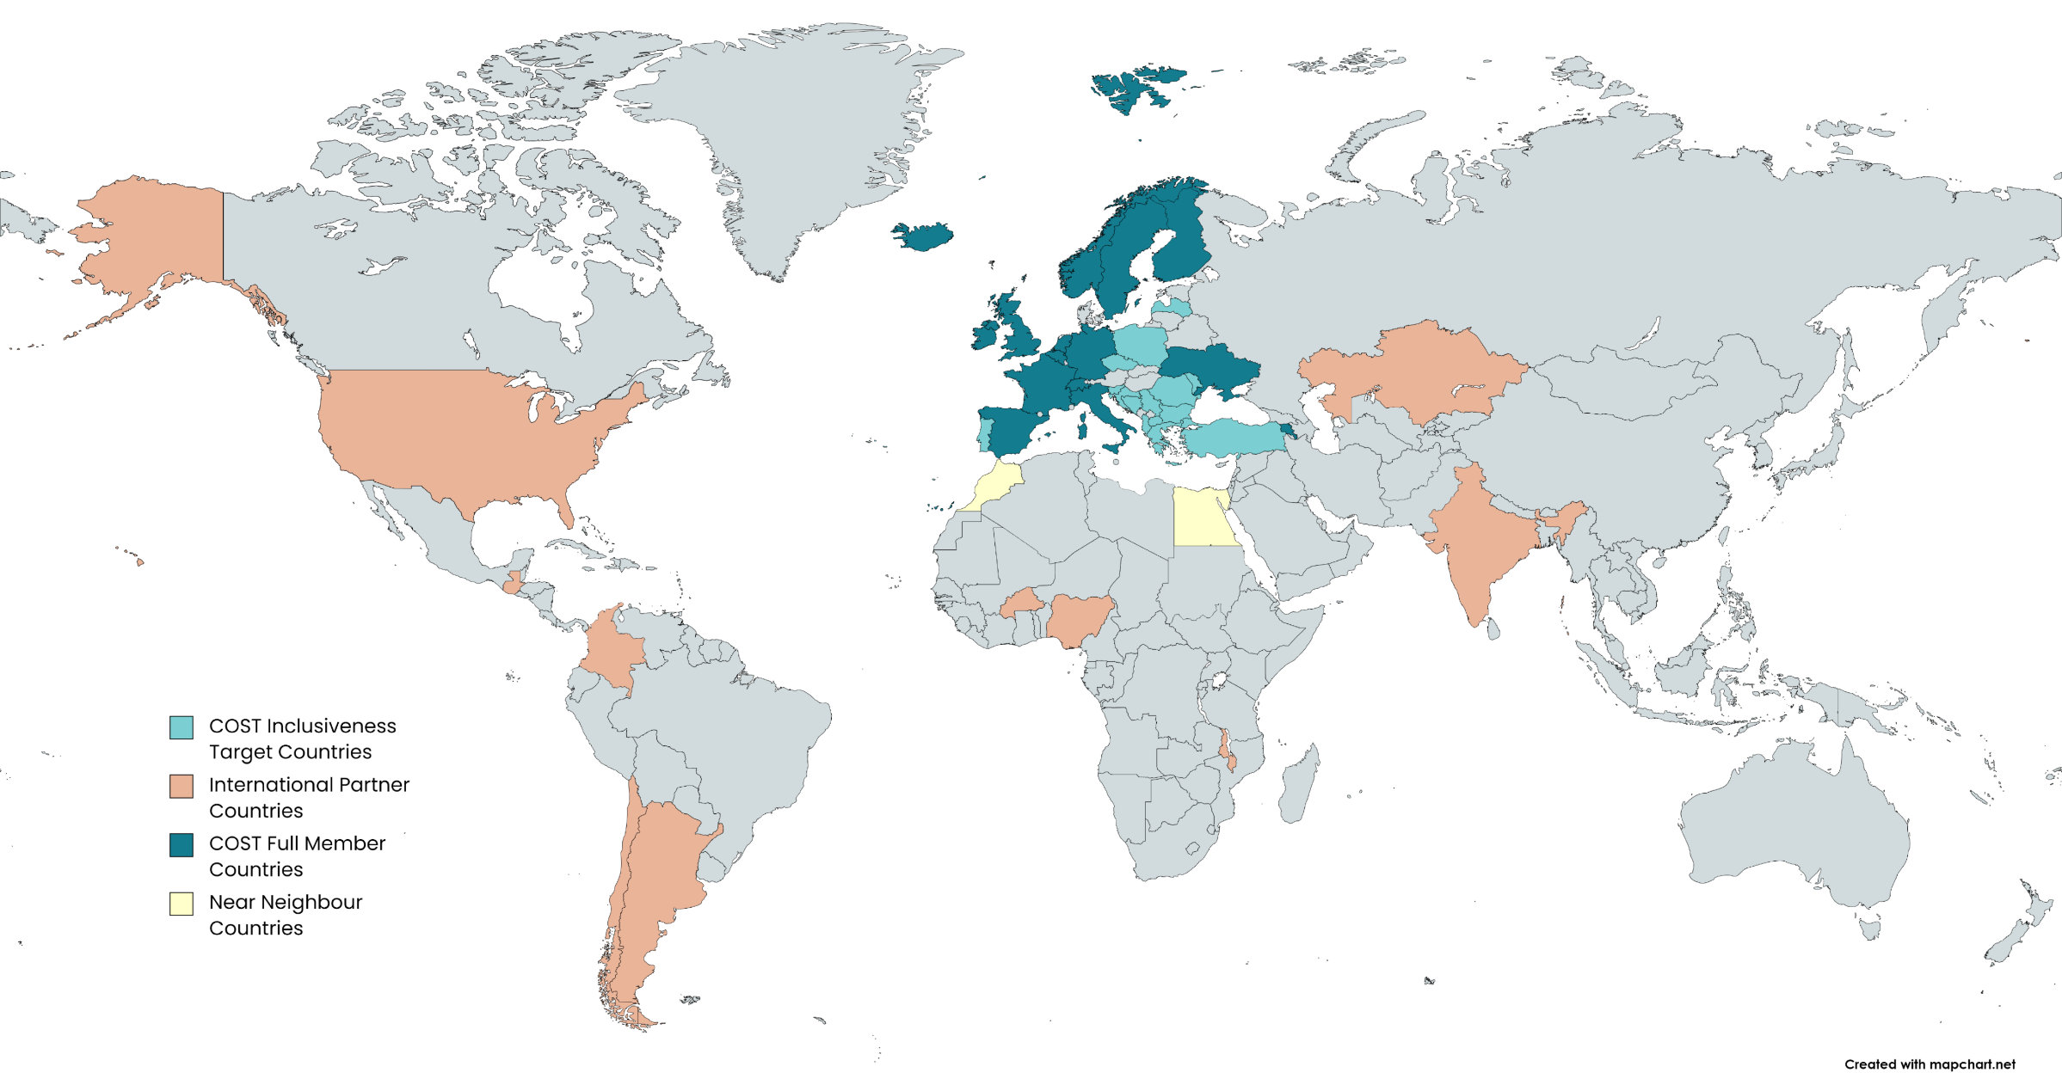
About us
Can be added to remind the audience which section it is.

Slide 17
About us
About us

