Slide 1
Title of the talk/event
Presenter & other info
Notes:
First slide

Slide 3
Title of the talk, event or personal message
Presenter & other info
ADVANCE-TB
ADVANCE-TB
www.advancetb.eu
@ADVANCE_TB
advance_tb@igtp.cat
Notes:
Last slide

Slide 4
To note:
The font used is Jost (Jost medium for titles & for highlighting and Jost regular for text)
You can download the Font family for free here as it does not come pre-installed: https://fonts.google.com/specimen/Jost
Don‘t forget to instal it in your computer after downloagding it.
The identity color of ADVANCE-TB is:
Cyan
HEX: #7ACDD0
RGB: 122, 205, 208
CMYK: 41, 1, 0, 18
Other colors are detailed in the visual identity guide and can be used to create contrast between slides (such as changing the background color) or to create contrast within a slide (color text or an object in a different color).
The previous three slides correspond to the Opening slide, Body slide, and Closing slide.
Find some examples in the following slides showing combinations and small changes that can be done for the body slides without affecting the overall design.
Notes:
Notes

Slide 5
Examples

Slide 6
Objectives – Research coordination
Enable multi-centre research through the design and implementation of a data registry
Facilitate the development, optimization and implementation of techniques/products for diagnostic and therapy/monitoring via experimental and clinical validation.
Develop experimental protocols facilitating comparison and reproducibility of assay results.
Establish priorities for future translational research lines.
Explore the opportunities for international coordinated TB research.

Slide 7
Outline
Brief introduction of panelists
Introduction. Bad news first evidences about impact of COVID pandemic into TB goals
Turn challenges into opportunities
Discussion with panelists about each of the proposed opportunities.
What’s next?

Slide 8
“The WHO TB Report launched today tells a typical underdog story: in spite of still fighting the COVID epidemic in 2022, in spite of incredibly low financial resources and limited visibility, in spite of the disbelief of so many - our TB healthcare providers, TB programme managers, nurses, community workers, laboratory technicians, advocates, pharmacists, epidemiologists came together like never before and managed to diagnose and treat 7.5 million people with TB the largest number of people with TB since 1995 when this report started being produced”
Lucica Ditiu, Executive Director, Stop TB Partnership.

Slide 9
About us

Slide 10
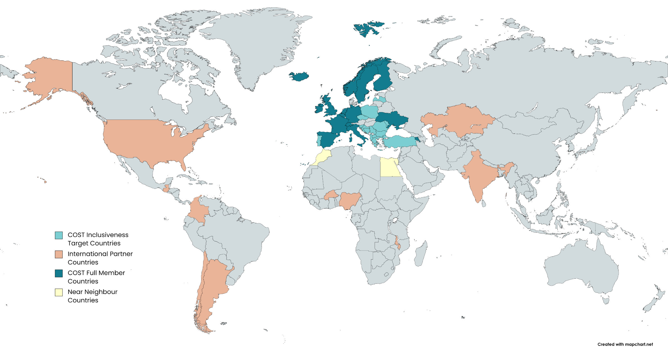
About us
Can be added to remind the audience which section it is.

